Slide 1
Real Estate Analysis

Slide 2
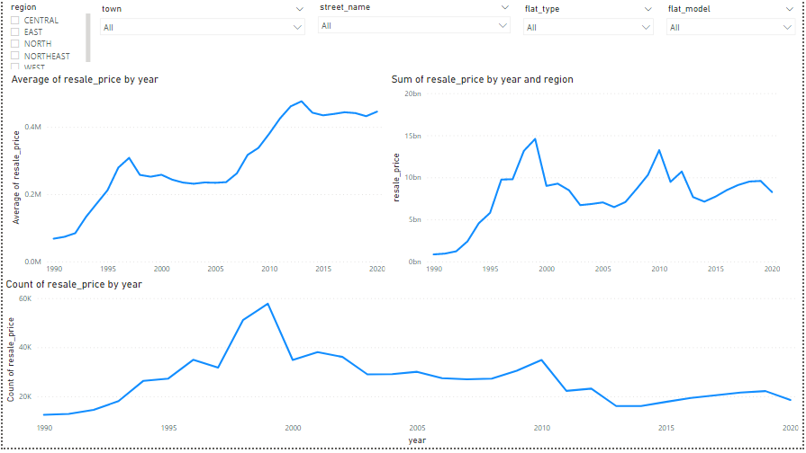
Average sale prices have surged 7x in 2020 as compared to 1990. But Sales No. have returned to 1990 level.
SG should confirm if sales numbers reflect the population’s demands/needs. Or if it is lower due to high prices.
Value of resale market is back to year 2000 levels after the most drastic drop.

Slide 3
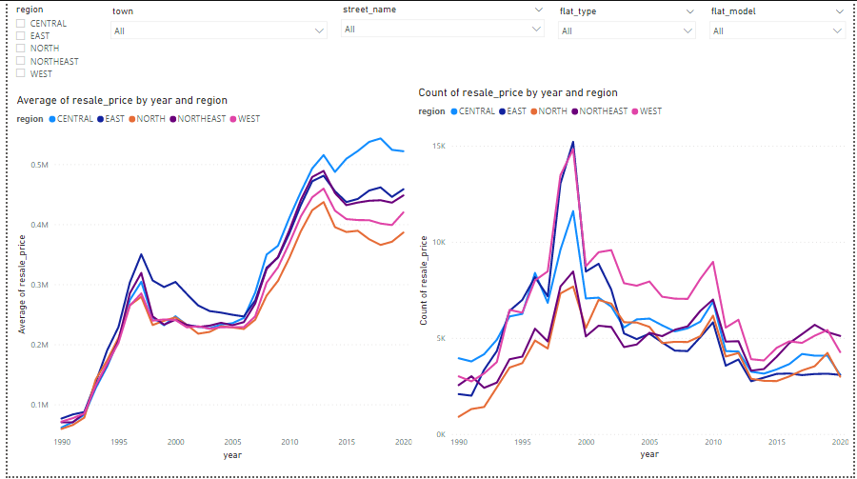
Central area prices are the most resistant to changes in the economic environment
Central area prices surged past other regions in 2006 and stayed highest since.
Central area prices even widened their lead in 2014 after ABSD was implemented.

Slide 4
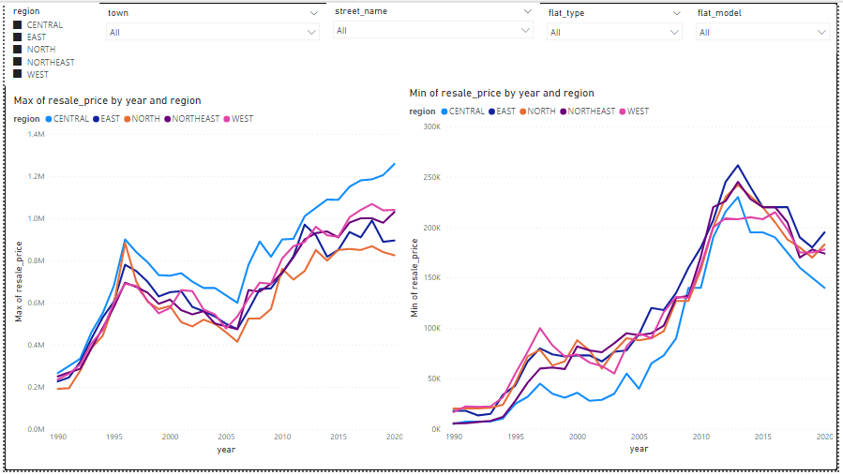
Investing in central region has the chance of highest returns but requires expert judgement
Central (light blue) has the highest max resale price as compared to all other regions
But it also has the lowest min resale price as compared to all other regions
Notes:
Add on slides to show which towns are the highest prices.

Slide 5
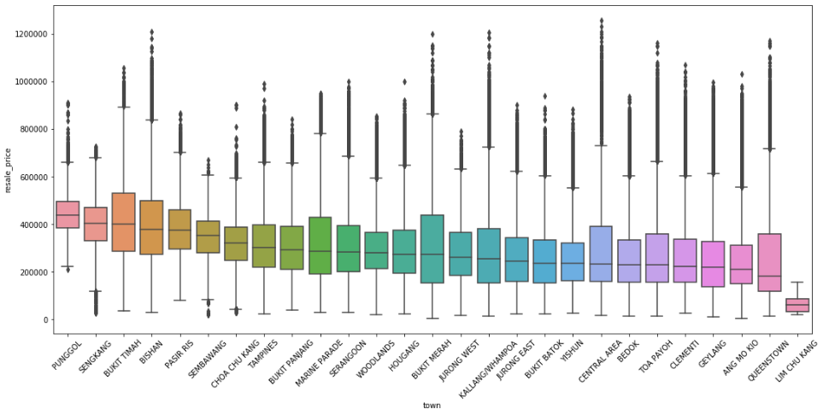
Bishan/Bukit Merah/Queenstown are valuable central region suburbs with the highest resale prices outside of Central Area.
They have the highest prices in the 3rd quartile with respectable outliers too
Bishan is especially valuable since it has one of the highest average resale prices too
Notes:
Add on slides to show which towns are the highest prices.

Slide 6
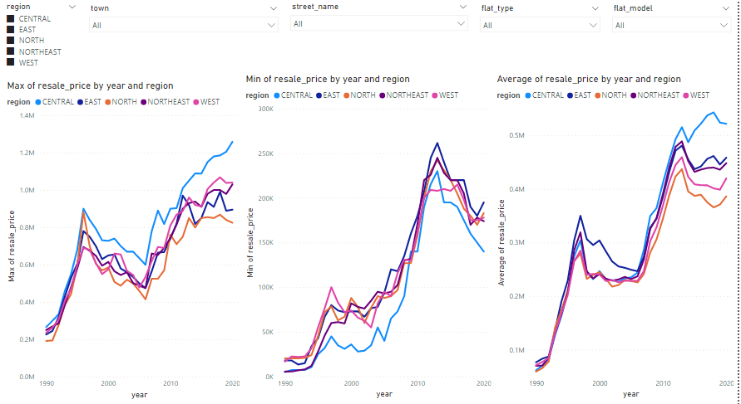
New or risk-averse buyers are recommended to purchase in the East region
East (dark blue) has the highest min resale price and 2nd highest average price as compared to other regions
Hence, with a lack of other info, real estate there is less likely to be a bad decision
Notes:
Add on slides to show which towns are the highest prices.

